Slide 1
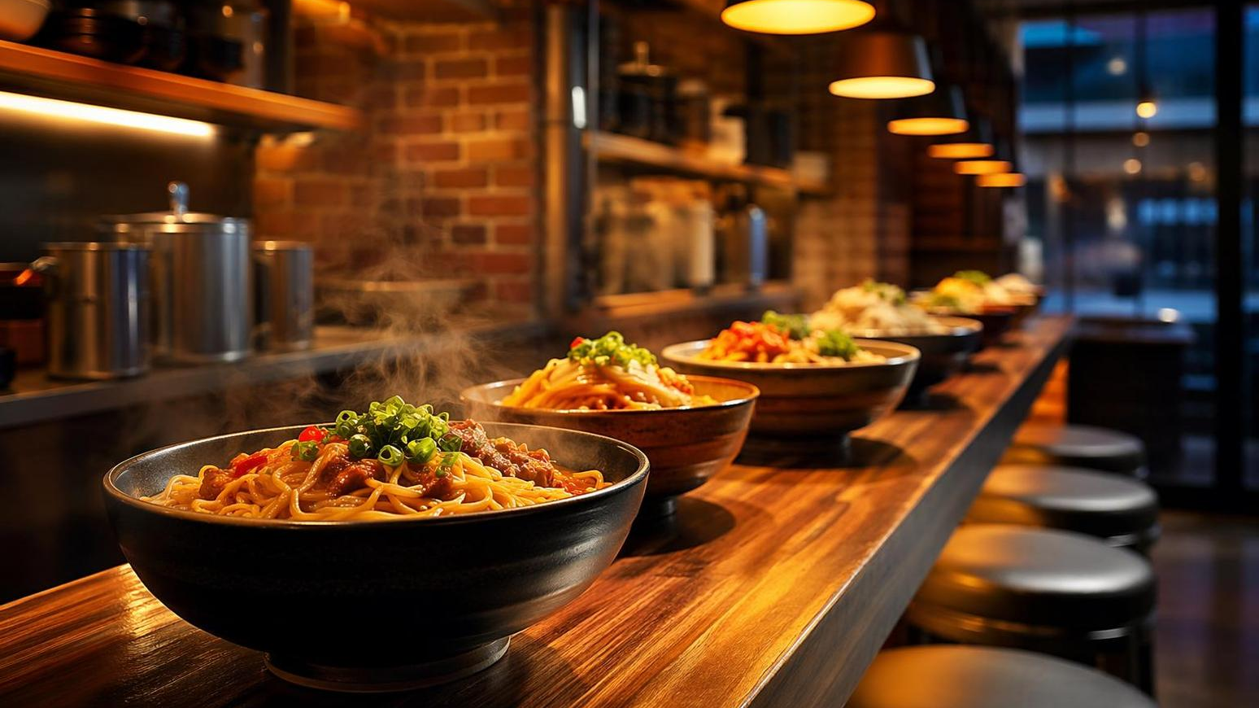


NOODLE HOUSE
Facebook Marketing Strategy
Founded by Karan & Rohit | Quick Service Noodle Restaurant
Notes:
Welcome everyone to the Noodle House Facebook Marketing Strategy presentation. Noodle House is a quick-service noodle restaurant co-founded by Karan and Rohit. Today we will walk through our comprehensive plan to leverage Facebook as the primary digital marketing channel to drive foot traffic, online orders, and brand awareness in our local community.

Slide 2
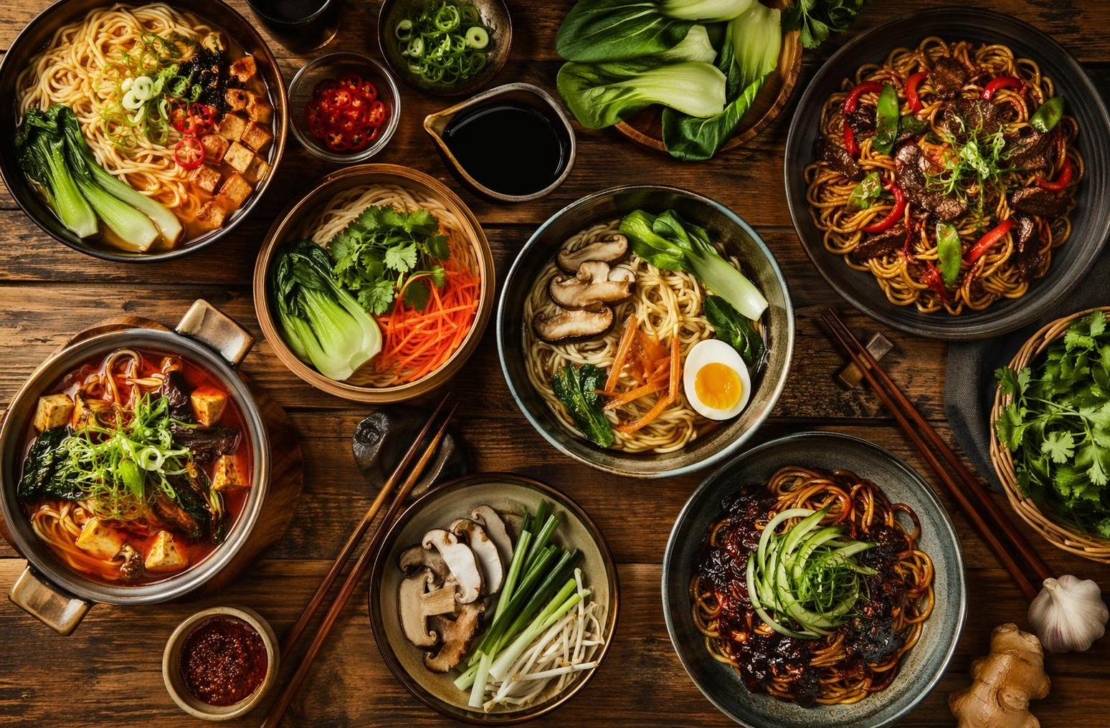
About Noodle House
Noodle House is a quick-service noodle restaurant founded by Karan and Rohit, two passionate food entrepreneurs on a mission to bring fresh, flavorful, and affordable noodle dishes to every neighborhood.
Our brand stands for speed, taste, and authenticity — serving up bowls that feel homemade in minutes, not hours.
Quick Service
Noodles & Bowls
2 Co-founders
Format
Specialty
Leadership
Notes:
Noodle House was born from Karan and Rohit's shared passion for authentic, fast, and affordable noodle dishes. We operate as a quick-service format — fresh ingredients, fast preparation, and wallet-friendly pricing. Our core differentiator is speed without sacrificing taste. Every bowl is made to order with quality ingredients, giving customers a homemade feel in under five minutes.

Slide 3




Why Facebook for Noodle House?
3B+
72%
Monthly active users on the platform
of diners use it for restaurant decisions
84%
$0.50-$1.50
choose a restaurant less than 1 hour before the meal
Average CPC — highly cost effective
Notes:
Let's talk about why Facebook is the right platform for us. With over 3 billion monthly active users, Facebook has unmatched scale. But more importantly for a local restaurant, 72 percent of diners use Facebook to make restaurant decisions based on photos and reviews. And here's the clincher — 84 percent of people choose where to eat less than one hour before the meal, which means we can catch them right in the decision window. Add to that an average cost-per-click of just 50 cents to a dollar fifty, and you have one of the most cost-effective channels for a local food business.

Slide 4


Advantages of Facebook Marketing
Precise Audience Targeting
Cost-Effective Advertising
Measurable Results
Reach people by age, location, interests, and behavior — serve ads only to those most likely to order
Start with as little as $5/day — one of the lowest cost-per-click platforms for local restaurants
Track every impression, click, and conversion in real time with built-in analytics dashboards
Massive Local Reach
Mobile-First Platform
Local Geo-Targeting
3 billion monthly users means your neighborhood customers are already scrolling — meet them where they are
84% of diners choose a restaurant within an hour — mobile ads catch them at the moment of decision
Show ads only to people within walking or driving distance of Noodle House locations
Notes:
Facebook marketing offers six distinct advantages that are particularly relevant for a restaurant like Noodle House. First, precise audience targeting lets us serve ads only to people most likely to visit — by age, location, food interests, and dining behavior. Second, it is incredibly cost-effective; we can start with as little as five dollars a day. Third, everything is measurable — we can track impressions, clicks, and conversions in real time. Fourth, the massive local reach means our neighborhood customers are already on the platform. Fifth, Facebook is mobile-first, which is critical since most dining decisions happen on phones. And sixth, geo-targeting ensures our ad budget reaches only people within walking or driving distance.

Slide 5

Target Audience
Young Professionals (22-35)
Office workers seeking quick, affordable lunch and dinner options nearby
College Students (18-24)
Budget-conscious foodies who discover restaurants through social media
Families & Couples
Weekend diners looking for a casual, flavorful meal experience
Local Foodies
Community members who follow restaurant pages for new dishes and deals
Geo-Targeting: 5-10 km radius around each location
Notes:
Our primary target audience falls into four key segments. Young professionals aged 22 to 35 represent our core lunch and dinner crowd — they want quick, tasty meals near their workplace. College students aged 18 to 24 are budget-conscious and highly active on social media, making them natural brand advocates. Families and couples drive our weekend traffic, looking for casual dining. And local foodies follow restaurant pages for new dishes and deals. All targeting will be geo-fenced to a 5 to 10 kilometer radius around each Noodle House location to maximize relevance and minimize wasted ad spend.

Slide 6




Content Strategy Pillars
Food Showcase
Community Stories
Engage & Entertain
Promotions & Offers
High-quality photos & videos of signature dishes, behind-the-scenes kitchen action, and plating moments
Founder journey of Karan & Rohit, team spotlights, customer testimonials, and local event partnerships
Polls, quizzes, user-generated content reposts, contests, and trending food challenges
Flash deals, combo offers, loyalty rewards, festival specials, and first-time visitor discounts
Notes:
Our content strategy rests on four pillars. Food Showcase is the hero — high-quality photos and videos of our signature dishes, behind-the-scenes kitchen action, and beautiful plating moments. Community Stories humanize our brand through Karan and Rohit's founder journey, team spotlights, and customer testimonials. Engage and Entertain drives interaction through polls, quizzes, user-generated content, and trending food challenges. And Promotions and Offers convert followers into customers with flash deals, combo offers, loyalty rewards, and festival specials.

Slide 7
Weekly Content Calendar
Day
Theme
Content Idea
Mon
Motivation
Founder story, team spotlight, or kitchen prep video
Tue
Tasty Tuesday
Feature dish of the week with close-up food photo
Wed
Behind Scenes
Kitchen action reel — noodle pulling, wok tossing
Thu
Throwback
Customer reviews, milestones, or growth highlights
Fri
Flash Deal
Weekend combo offer or limited-time discount post
Sat
Reel / Video
Fun short-form video — food ASMR, cooking tips
Sun
Community
Poll, quiz, or user-generated content reshare
Post consistently 5-7x per week | Best times: 11 AM-1 PM & 6-9 PM
Notes:
Consistency is key on Facebook, so we have mapped out a seven-day content calendar. Monday is Motivation — founder stories or team spotlights. Tuesday is Tasty Tuesday featuring the dish of the week. Wednesday goes behind the scenes with kitchen action reels. Thursday is Throwback with customer reviews and milestones. Friday is Flash Deal day with weekend combo offers. Saturday focuses on Reels and video — food ASMR, cooking tips. Sunday is Community day with polls and user-generated content reshares. We recommend posting five to seven times per week, with optimal timing between 11 AM to 1 PM for lunch crowd and 6 PM to 9 PM for dinner decisions.

Slide 8
Sample Post Ideas
Photo Post
Order Now
"Our spicy garlic noodles are made fresh every single order. Come try the bowl everyone's talking about!"
Video Reel
Watch Now
"60 seconds of noodle magic — watch Chef pull hand-stretched noodles live at Noodle House!"
Flash Deal
Claim Offer
"This weekend only: Buy 1 Get 1 Free on all signature bowls. Tag your noodle buddy!"
Notes:
Here are three concrete post examples we plan to run. The first is a high-quality photo post showcasing our spicy garlic noodles with a direct order CTA. The second is a 60-second video reel of our chef pulling hand-stretched noodles — video content consistently outperforms static images by two times on engagement. The third is a flash deal post — Buy One Get One Free on signature bowls — designed to drive urgency and encourage tagging friends. Each post type serves a different funnel stage: awareness, engagement, and conversion.

Slide 9


Facebook Ads Strategy
Carousel Ads
Video / Reels Ads
Local Awareness Ads
Showcase 3-5 signature dishes in a swipeable format. Each card features one dish with pricing and a direct order link.
15-30 second food prep videos or customer experience clips. Video ads get 2x more engagement than static posts.
Reach people within 5-10 km with special offers. Include map directions and 'Get Directions' CTA button.
Notes:
For paid advertising, we recommend three core ad formats. Carousel ads let us showcase three to five signature dishes in a swipeable format, each with pricing and a direct order link — great for menu discovery. Video and Reels ads using 15 to 30 second food prep clips generate two times more engagement than static ads. And Local Awareness ads with geo-targeting reach people within 5 to 10 kilometers, including map directions and a Get Directions call-to-action button — perfect for driving foot traffic.

Slide 10
Ad Targeting & Budget
Targeting Strategy
Recommended Budget
Location: 5-10 km radius around each outlet
Age: 18-45, skewing 22-35 for working professionals
Interests: Asian cuisine, food delivery, dining out, cooking
Custom Audiences: Website visitors, page engagers
Lookalike Audiences: Based on existing customer data
Launch Phase (Month 1-2)
$500-800/mo
Brand awareness & page growth
Growth Phase (Month 3-6)
$800-1,500/mo
Lead gen & order conversions
Scale Phase (Month 6+)
$1,500-2,000/mo
Retargeting & loyalty campaigns
Expected CPC: $0.50-$1.50 | Expected Cost Per Lead: $3-$15
Notes:
Our targeting strategy focuses on location-based audiences within a 5 to 10 kilometer radius, aged 18 to 45 with a skew toward 22 to 35 working professionals. Interest targeting includes Asian cuisine, food delivery, dining out, and cooking enthusiasts. We will also build Custom Audiences from website visitors and page engagers, plus Lookalike Audiences based on existing customer data. On budget, we recommend three phases: Launch at 500 to 800 dollars per month for brand awareness, Growth at 800 to 1500 for lead generation and conversions, and Scale at 1500 to 2000 for retargeting and loyalty campaigns. Expected CPC is 50 cents to a dollar fifty, with cost per lead of 3 to 15 dollars.

Slide 11
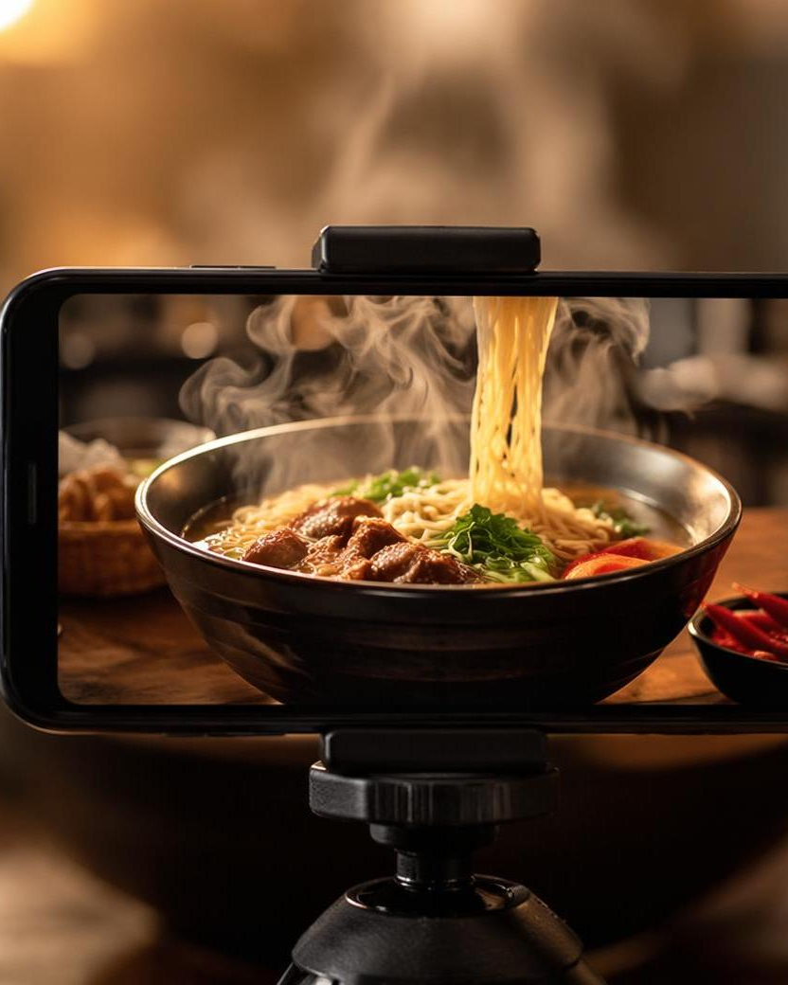
Reels & Video Strategy
Video content gets 2x more engagement. Meta has made all videos into Reels — making short-form video essential for reach.
Kitchen Action
Noodle-pulling, wok-tossing, plating shots — 15-30 sec
Dish of the Day
Close-up food ASMR with sizzling sounds
Customer Reactions
First-bite reaction videos from real diners
Founder Stories
Karan & Rohit sharing the Noodle House journey
Notes:
Video is no longer optional on Facebook. Meta has consolidated all video into the Reels format, making short-form video essential for organic reach. We plan four types of video content: Kitchen Action showing noodle-pulling and wok-tossing in 15 to 30 second clips. Dish of the Day with close-up food ASMR featuring sizzling sounds. Customer Reactions capturing first-bite moments from real diners. And Founder Stories where Karan and Rohit share the Noodle House journey. Video content consistently drives two times more engagement and significantly better algorithmic distribution than static posts.

Slide 12



Community Building & Engagement
Respond to Every Comment
Reply within 1 hour. Personalized responses build loyalty and boost algorithmic reach.
Encourage Reviews
Ask satisfied diners to leave reviews. Offer a free add-on as a thank-you incentive.
Run Contests & Polls
'Name our new dish' or 'Pick the next special' — drives massive engagement.
Leverage Messenger
Set up auto-replies for FAQs: menu, hours, location. Use chatbots for ordering.
Goal: Build a community of regulars who promote Noodle House organically
Notes:
Community building is how we turn one-time visitors into loyal regulars. Four key tactics: First, respond to every comment within one hour — personalized replies build loyalty and boost our algorithmic reach. Second, actively encourage reviews by asking satisfied diners and offering a free add-on as a thank-you. Third, run contests and polls like naming a new dish or picking the next special — these drive massive engagement spikes. Fourth, leverage Messenger with auto-replies for FAQs like menu, hours, and location, and eventually chatbot ordering. The ultimate goal is to build a self-sustaining community that promotes Noodle House organically through word of mouth.

Slide 13
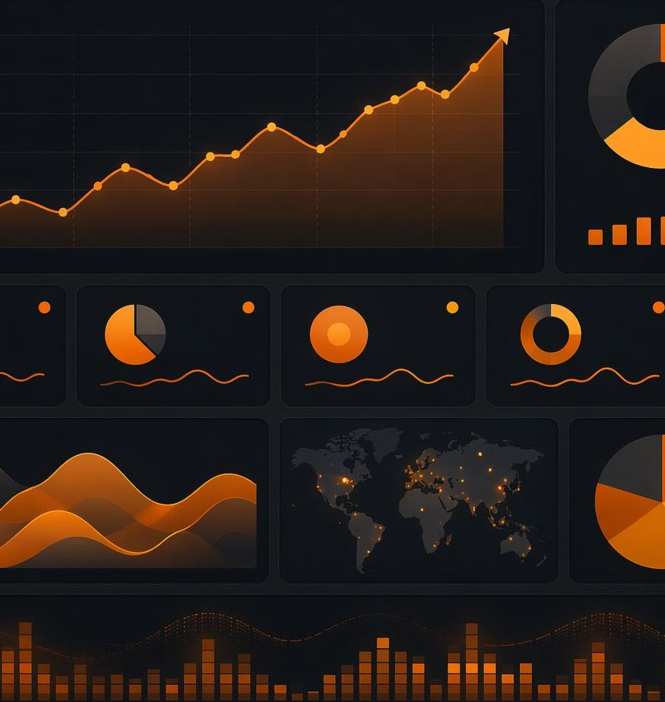

KPIs & Success Metrics
Page Reach
Engagement Rate
10K+ monthly
3-5%
Organic + paid impressions
Likes, comments, shares
Click-Through Rate
Conversions
1.5-3%
50-100/mo
Ad CTR benchmark
Orders from Facebook
Notes:
To measure success, we are tracking four key performance indicators. Page Reach target is 10,000 plus monthly impressions combining organic and paid. Engagement Rate target is 3 to 5 percent across likes, comments, and shares — well above the industry average of 1 to 2 percent. Click-Through Rate target is 1.5 to 3 percent on our ads. And Conversions target is 50 to 100 orders per month directly attributable to Facebook. We will review these metrics weekly and optimize our top-performing content and ad creative based on the data.

Slide 14
90-Day Roadmap
Month 1: Foundation
Month 2: Growth
Month 3: Scale
Set up & optimize Facebook Business Page
Create branded content templates
Launch page with 15+ initial posts
Begin $500/mo ad spend on awareness
Set up Messenger auto-replies
Ramp up to daily posting schedule
Launch carousel & video ad campaigns
Start collecting customer reviews
Run first contest or giveaway
Increase budget to $800/mo
Introduce retargeting campaigns
Scale budget to $1,200-1,500/mo
Launch loyalty program promotions
Analyze data & optimize top performers
Plan month 4-6 strategy expansion
Notes:
Our implementation follows a 90-day roadmap across three phases. Month one is Foundation — setting up and optimizing our Facebook Business Page, creating branded content templates, launching with 15 plus initial posts, beginning 500 dollars per month ad spend on awareness, and setting up Messenger auto-replies. Month two is Growth — ramping to daily posting, launching carousel and video ad campaigns, collecting customer reviews, running our first contest, and increasing budget to 800 dollars. Month three is Scale — introducing retargeting campaigns, scaling budget to 1200 to 1500 dollars, launching loyalty program promotions, analyzing data to optimize top performers, and planning the month 4 to 6 strategy expansion.

Slide 15
Let's Build Noodle House
Into a Facebook Powerhouse
Karan & Rohit | Noodle House
Ready to serve great noodles — and even better marketing.
Notes:
Thank you for your time today. Noodle House is ready to serve great noodles and even better marketing. Karan and Rohit are committed to building Noodle House into a Facebook powerhouse — turning local scrollers into loyal diners. We look forward to your questions and feedback on this strategy. Let's make it happen!

